Slide 1

Unveiling Data-Driven Insights: Advanced SQL Analysis on E-Pharma Products

Slide 2
Unveiling Data-Driven Insights: Advanced SQL Analysis on E-Pharma Products
This report provides deep insights into pharmaceutical product pricing, discounts, and market trends using advanced SQL queries, helping businesses make data-driven decisions
Objective & Business Impact
  Understanding pricing & discount strategies across different company types.
  Identifying market trends for different medicine forms (tablets, injections, creams, etc.).
  Comparing RX vs. Non-RX medicine pricing & discounts.
  Analyzing manufacturer trends across different regions.
  Finding the most competitive and premium-priced pharma brands.
SQL Techniques Used
: Window Functions (rank,row_number,dense_rank)
: Common Table Expressions (CTEs) for structured analysis
: Subqueries for filtering and trend detection
: Aggregations & Grouping for business-level insights

Slide 3
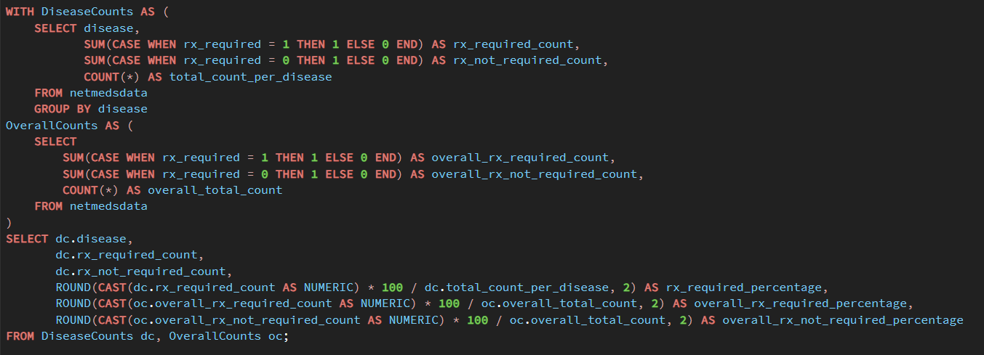
Summary Statistics of Prescription and Non-Prescription Medications

Slide 4
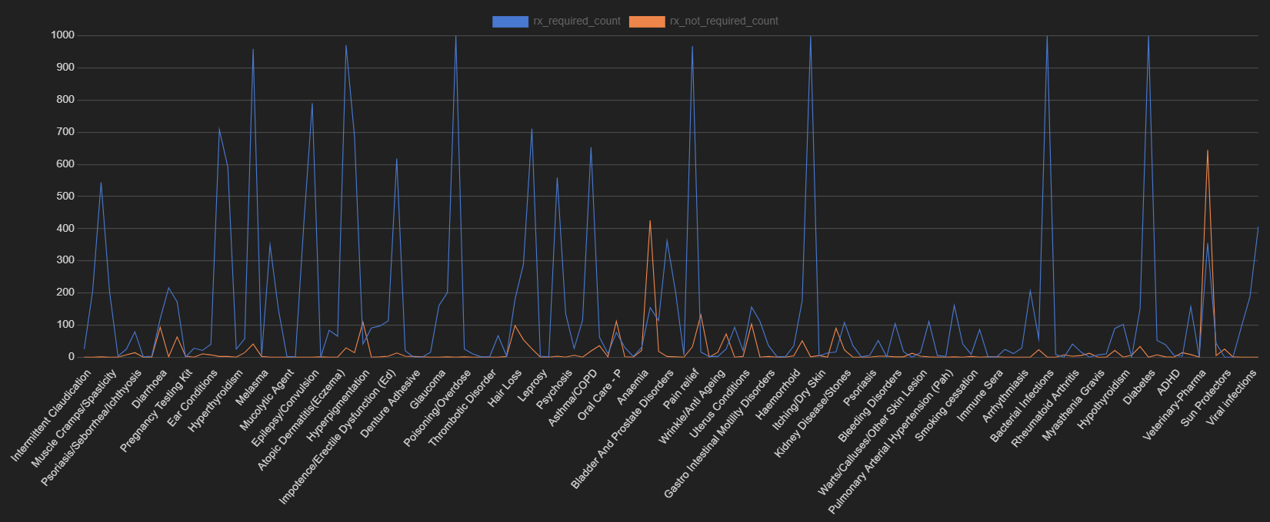
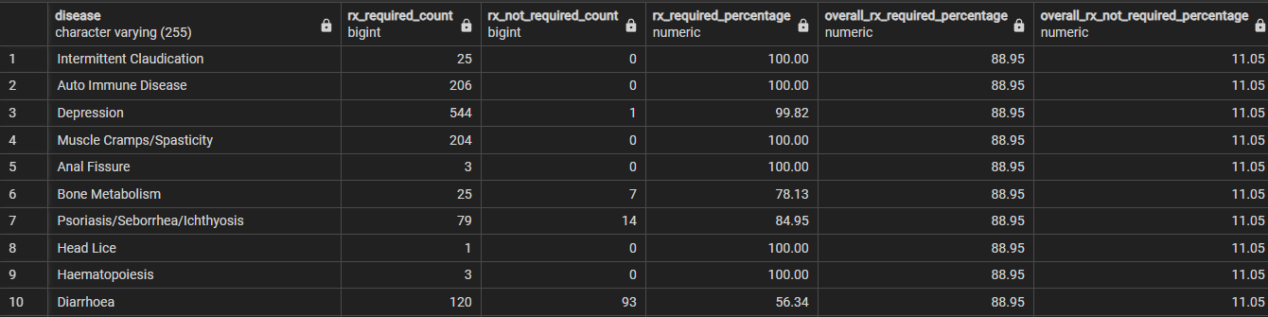
Visualization of output

Slide 5
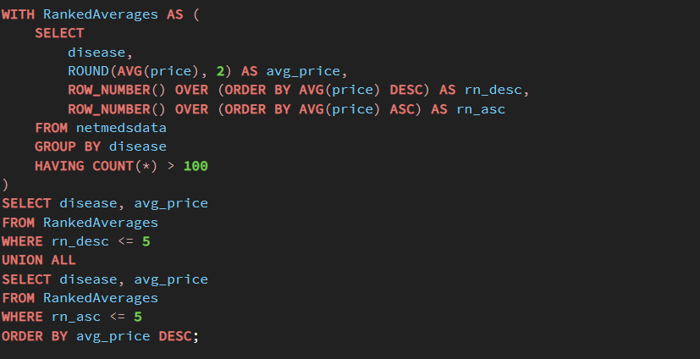
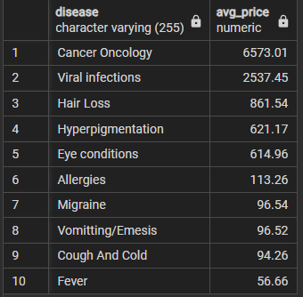
Top 5 and Bottom 5 Diseases by Average Price

Slide 6
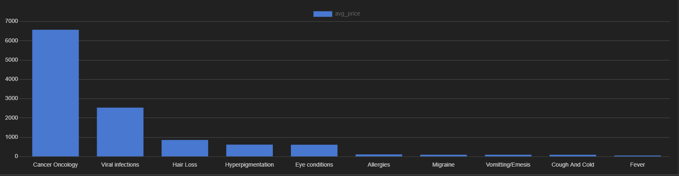
Cancer Oncology (6573.01): Indicates resource-intensive cancer care.
Anesthesia General (4156.50): Suggests complex procedures needing specialized expertise.
Wrinkle/Anti-Aging (1469.18): Shows high cost of advanced aesthetic treatments.
Parasitic Worms (48.19) to Mydriasis (92.43): Lower costs for common ailments needing less intensive care.

Slide 7
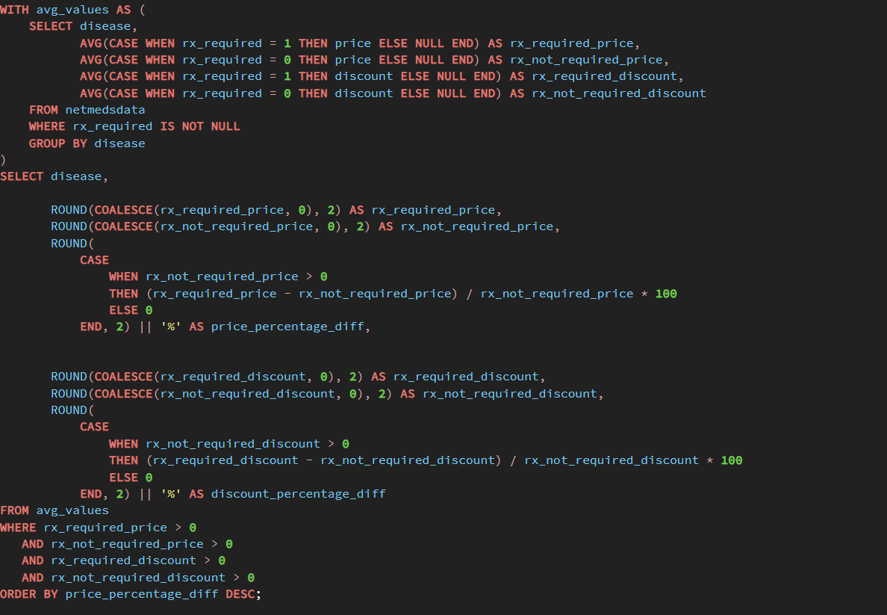
Average Price and Discount Comparison for Diseases Based on Prescription Requirement

Slide 8
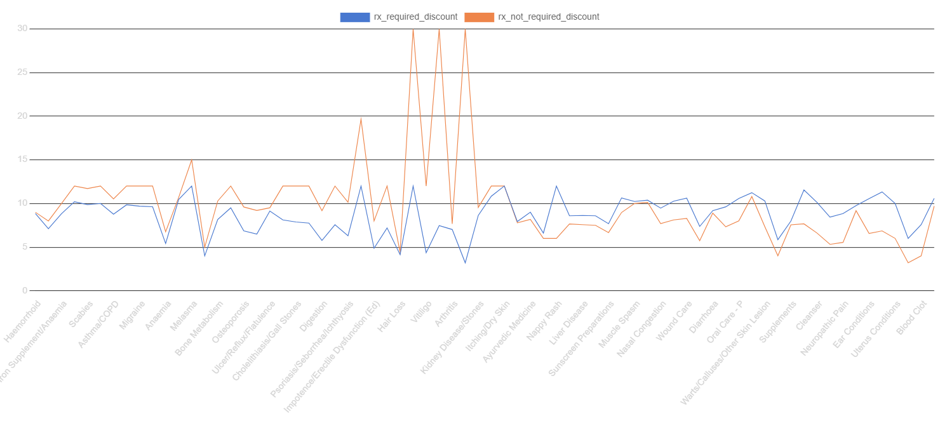
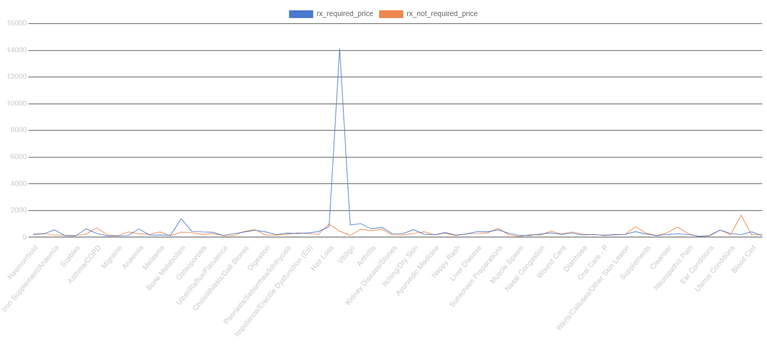
Discount vs Rx
Price vs Rx

Slide 9
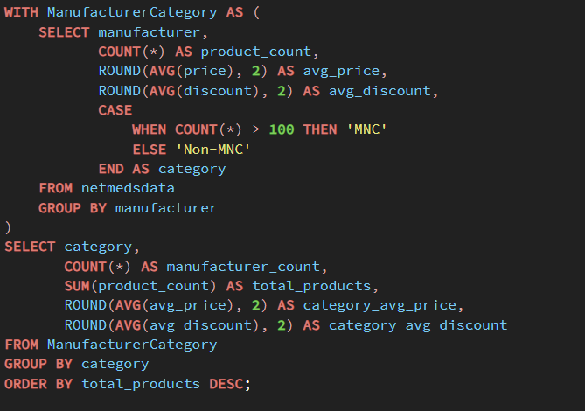
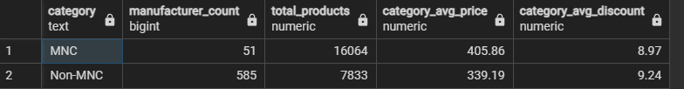
Analysis of Manufacturers by Product Count, Average Price, and Average Discount, Grouped by MNC/Non-MNC Category

Slide 10
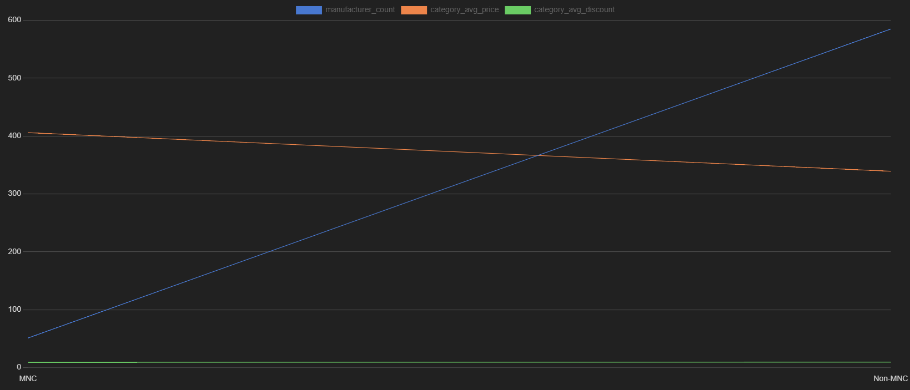
Visualization of output

Slide 11
Business Recommendations for Online Pharmacy Expansion
Optimize Product Availability:
  MNCs have a dominant presence in terms of product count. To maintain a competitive edge, I recommend strengthening partnerships with top-selling MNC brands to ensure a robust product lineup.
  Since Non-MNCs focus on affordability, expanding the Non-MNC range can help attract budget-conscious customers and increase market penetration.
Strategic Pricing & Discounts:
  MNCs maintain higher pricing with slightly lower discounts. I suggest leveraging brand reputation and quality to justify premium pricing while offering strategic discounts on selected products to drive conversions.
  Non-MNCs rely on higher discounts to attract buyers. To maximize sales, I recommend testing targeted promotions, cashback offers, and bulk purchase discounts to see if they drive higher revenue.
Market Expansion Strategy:
  MNC products tend to attract urban, brand-conscious customers, whereas Non-MNCs cater to price-sensitive buyers in Tier 2 & Tier 3 cities.
  I recommend expanding the Non-MNC product portfolio in smaller cities and rural areas while maintaining a strong MNC presence in urban markets.
Targeted Marketing Approach:
  For premium customers, introduce loyalty programs and exclusive deals on MNC products to enhance customer retention.
For budget-conscious customers, focus on promotions and affordability-driven campaigns to increase engagement with Non-MNC products.
Next Steps for Growth:
Analyze customer purchase data to personalize pricing and discount strategies.
Balance MNC & Non-MNC offerings to cater to different customer segments.
Run localized marketing campaigns to expand into new markets effectively.

Slide 12
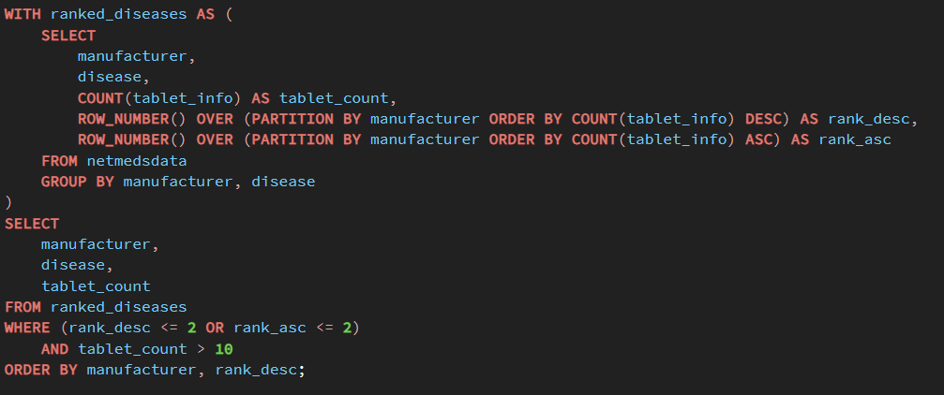
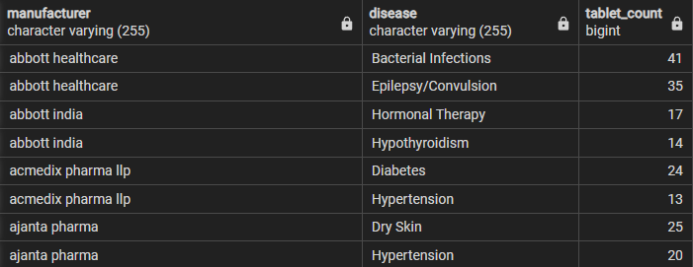
Top 2 and Bottom 2 Diseases by Tablet Count for Each Manufacturer with Minimum Count Filter

Slide 13
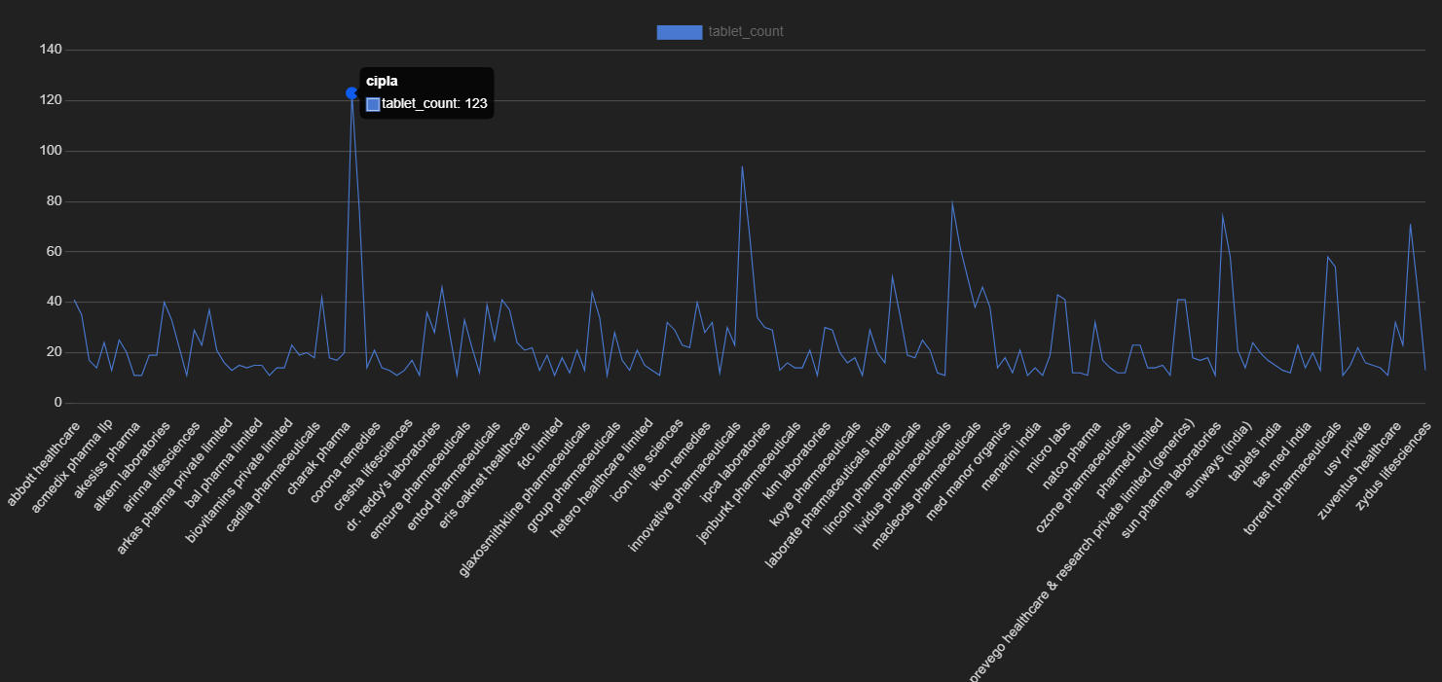

Slide 14
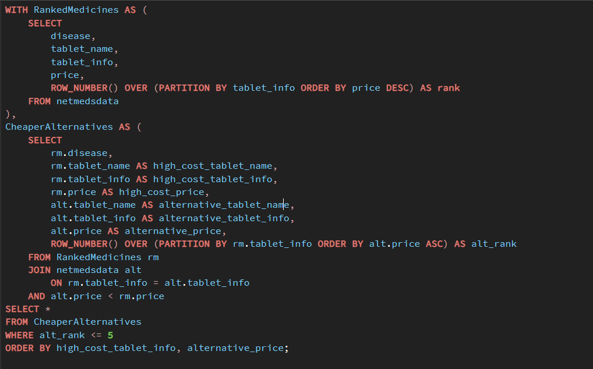
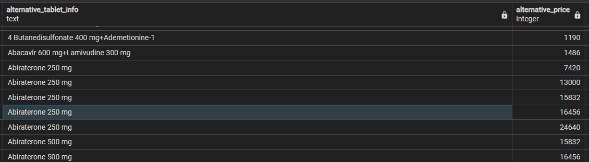
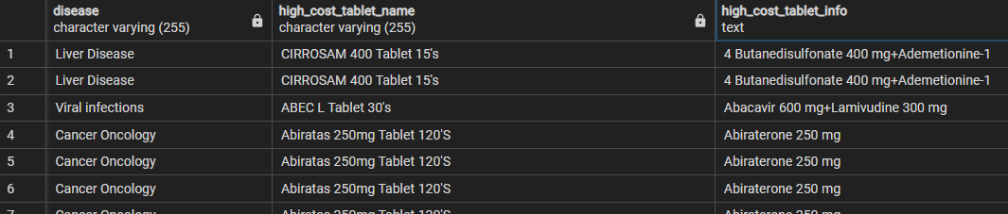
Top 5 High-Cost Medicines and Their Cheaper Alternatives by Disease

Slide 15
Insights From Query
Higher Sales & Lower Cart Abandonment:
Customers see cheaper alternatives, making them more likely to complete a purchase.
Better Customer Experience & Retention:
Users save money and find substitutes easily, increasing trust & loyalty.
Reduced Lost Sales (Out-of-Stock Solutions):
If a medicine is unavailable, Netmeds suggests similar alternatives, preventing lost revenue.
Data-Driven Pricing & Supplier Negotiation:
Helps Netmeds track demand for cheaper substitutes, enabling better pricing strategies & bulk purchase deals.
Result: More purchases, happy customers, and a stronger market position!

Slide 16
Insights From Query
Personalized medicine recommendations based on a customer's past purchase behavior can significantly boost sales & user satisfaction.
Customer Segmentation Based on Purchase History:
  High-spending customers → Show premium alternatives first.
  Budget-conscious customers → Show cheaper alternatives first.
Dynamic Pricing & Recommendations:
  If a user frequently buys expensive medicines, prioritize higher-cost alternatives in search results.
  If a user prefers affordable options, highlight the cheapest substitutes upfront.
Boosting Conversions & Revenue:
  Personalized pricing increases the chance of a sale.
  Netmeds can upsell premium products to high-spending users.
  Discounts can be targeted at price-sensitive customers to retain them.
🚀 Business Impact:
✔ Higher conversion rates (customers see what they prefer).
✔ Increased revenue & profitability through smart recommendations.
✔ Stronger customer loyalty by making shopping more relevant.

Slide 17
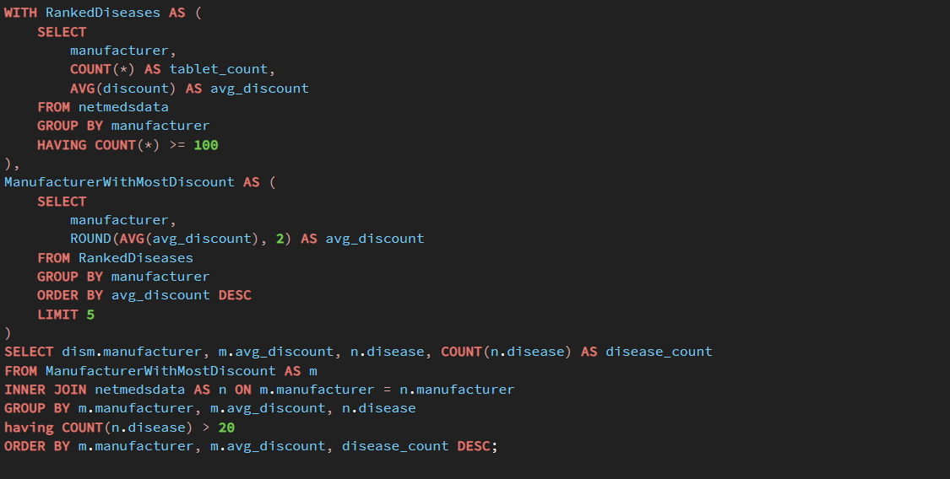
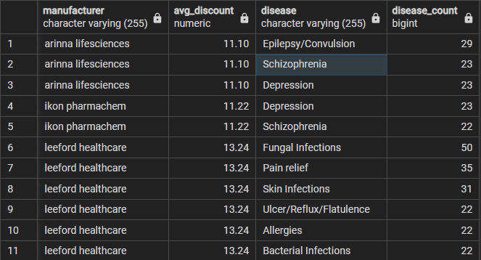
"Leading Manufacturer with Highest Average Discount Based on Top 20 Diseases"

Slide 18
"Pharma Giants: Highest Discount Providers with 20+ Medicines per Disease"
Arinna Lifesciences
Ikon Pharmachem
Leeford Healthcare
Offer the most discounts 💰
Manufacture 100+ medicines 🏭
Have 20+ medicines per disease category 💊
How This Data Helps Netmeds:
Strategic Partnerships – Netmeds can partner with these companies to get better bulk pricing & exclusive deals.
Targeted Discounts & Promotions – Prioritize these brands for discount campaigns to attract more buyers.
Better Inventory Management – Since they manufacture many medicines, Netmeds can stock more alternatives.
Personalized Recommendations – Show discounted medicines from these brands to price-sensitive customers.

Slide 19
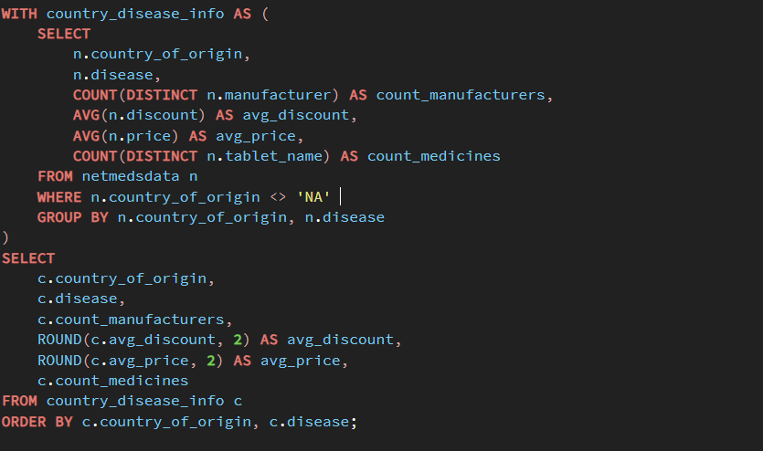
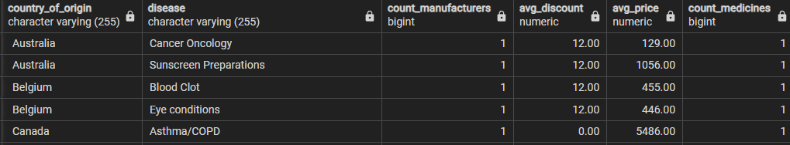
Country-wise Disease Distribution: Manufacturer Count, Average Discount, Price, and Medicine Count

Slide 20
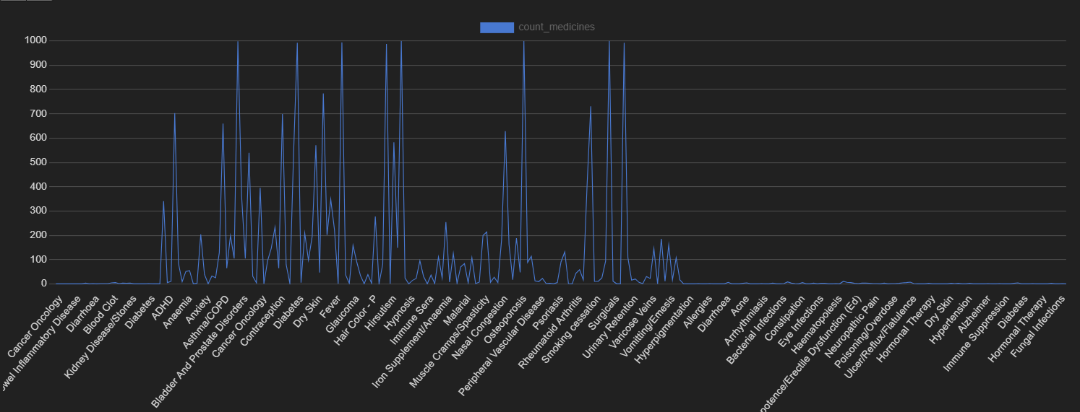
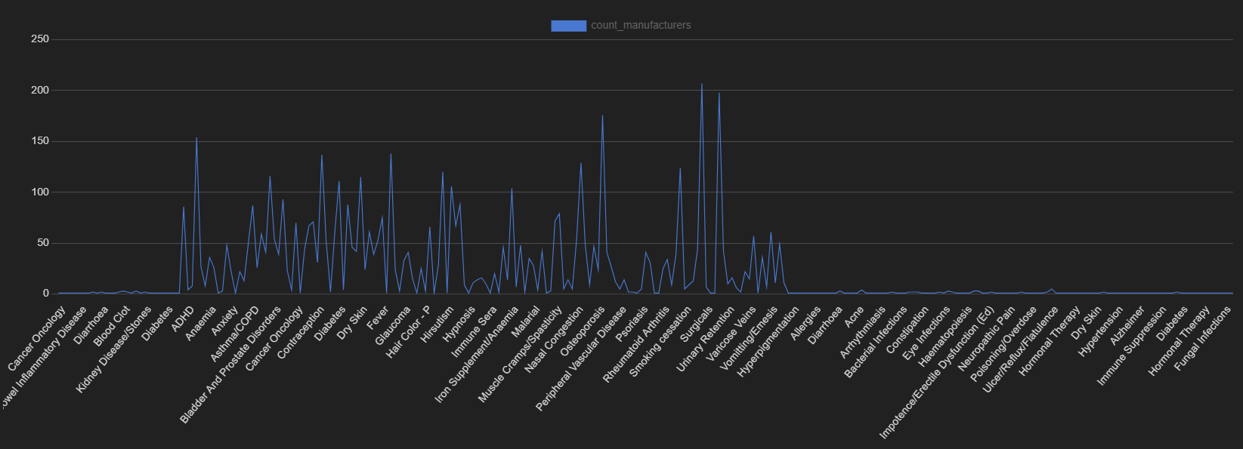
Medicines Count vs Disease
Manufacturers Count vs Disease

Slide 21
Insights From Query
High Demand Chronic Conditions: Ulcer/Reflux/Flatulence, Hypertension, High Cholesterol, Fungal Infections, Diabetes, Bacterial Infections, Asthma/COPD, Neuropathic Pain, Epilepsy are prevalent, with a large number of manufacturers and medicines available. This points to a significant customer base for these chronic conditions.
Rare/Acute/Specialized Conditions: Bleeding Disorders, Hypnosis, Multiple Sclerosis, Pulmonary Hypertension, Heart Failure, Cancer Oncology have significantly fewer manufacturers and medicines, likely due to lower prevalence and potentially more specialized distribution channels.
Supplements Popular: Supplements also have a good number of manufacturers and medicines, suggesting a growing interest in preventive health.
Pain Relief Dominance: Pain relief has an exceptionally high number of medicines (1000), indicating a large and diverse market.

Slide 22
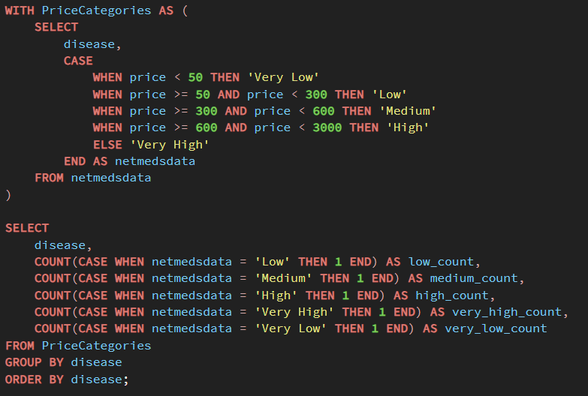
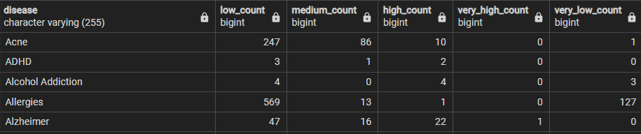
Price Distribution by Disease: Count of Medicines in Each Price Category

Slide 23
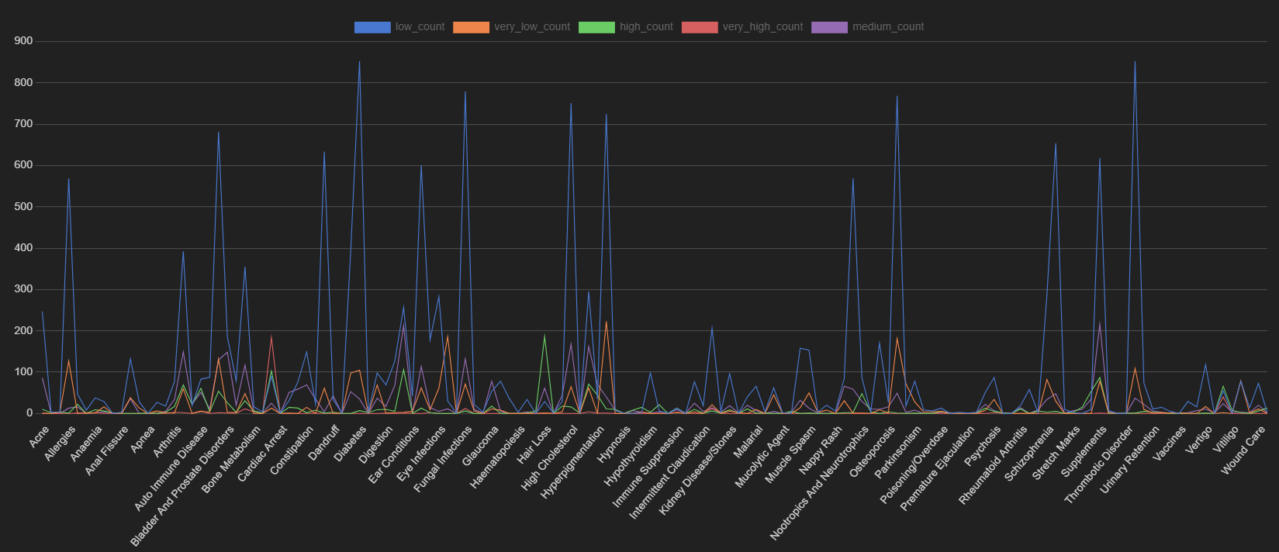
Visualization from output

Slide 24
Insights from Query
Very High Price Category: Cancer Oncology has the highest number of medicines (184), followed by Viral Infection and Anemia (12 each). Blood clot treatments also have a significant presence (11).
High Price Category: Hair Loss dominates with 186 medicines, followed by Supplements, Hormonal Therapy, Dry Skin, and Cancer Oncology (80-120).
Medium Price Category: Supplements lead with 216 medicines, followed by Asthma/COPD, Bladder/Prostate Problems, High Cholesterol, and Hormonal Therapy (120-170).
Low Price Category: Ulcer/Reflux/Diabetes have the highest counts (around 850), followed by a range of chronic conditions like Neuropathic Pain, Skin Infections, Hypertension, High Cholesterol, Cough/Cold, Bacterial Infections, and Allergies (600-800).
Very Low Price Category: Hypertension again leads with 223 medicines, followed by Fever and Pain Relief (around 180).

Slide 25
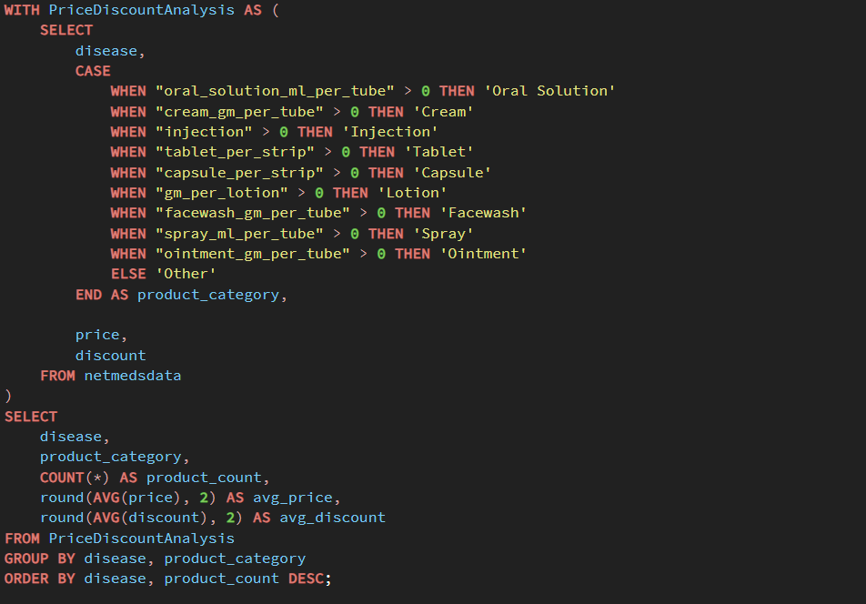
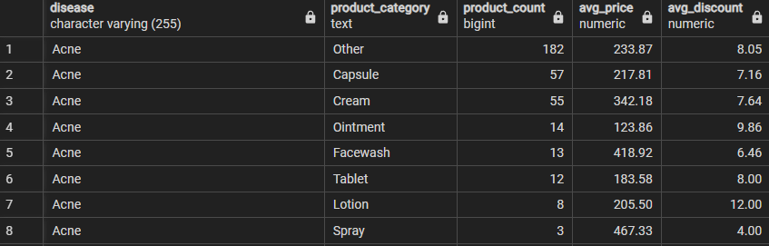
"Analysis of Medicine Types and Pricing by Disease"

Slide 26
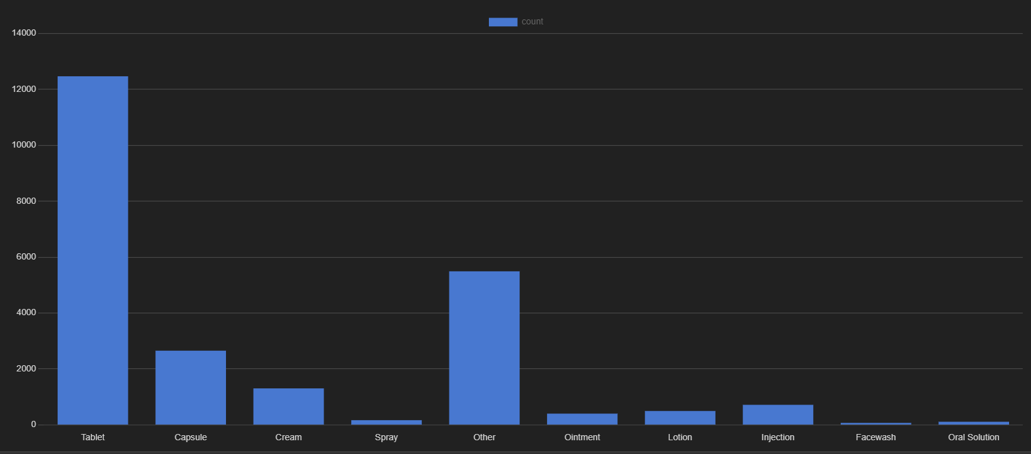
Tablets Dominate: Tablets are by far the most common type of medicine, with a count exceeding 12,000. This suggests a strong preference or market prevalence for tablet-based medications.
Patient Preference: The overwhelming preference for tablets could be due to factors like ease of consumption, convenience, established habits, or cost-effectiveness.

Slide 27
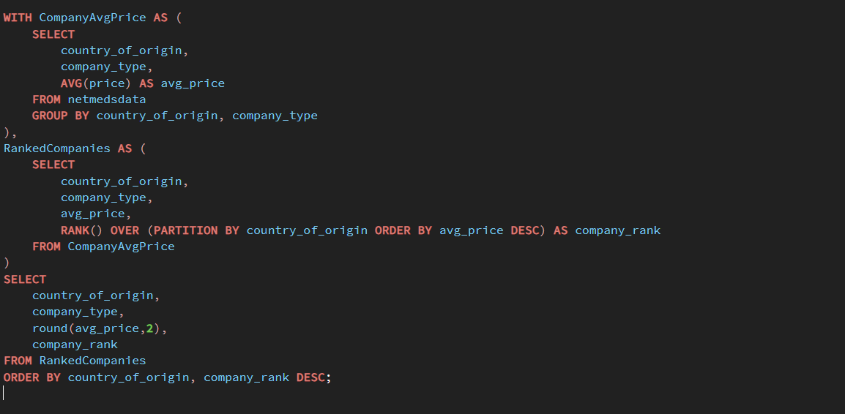
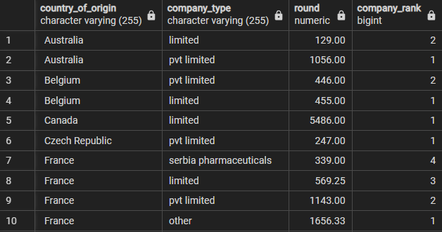
"Ranking Companies by Average Price within Each Country of Origin"

Slide 28
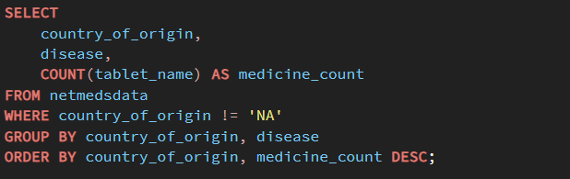
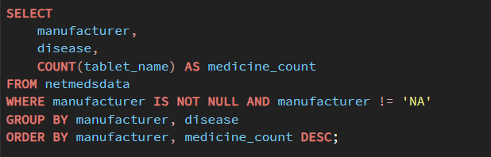
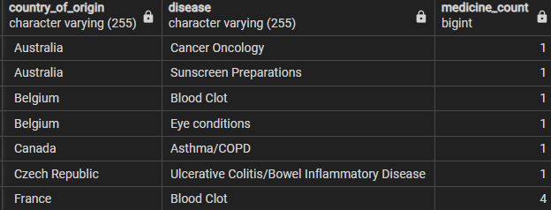
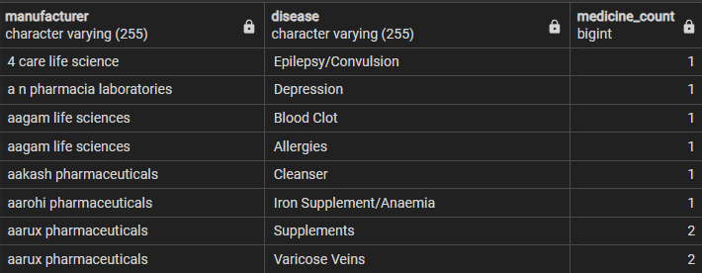
"Medicine Count by Country of Origin and Disease“ and
Medicine Count by Manufacturer and Disease"

Slide 29
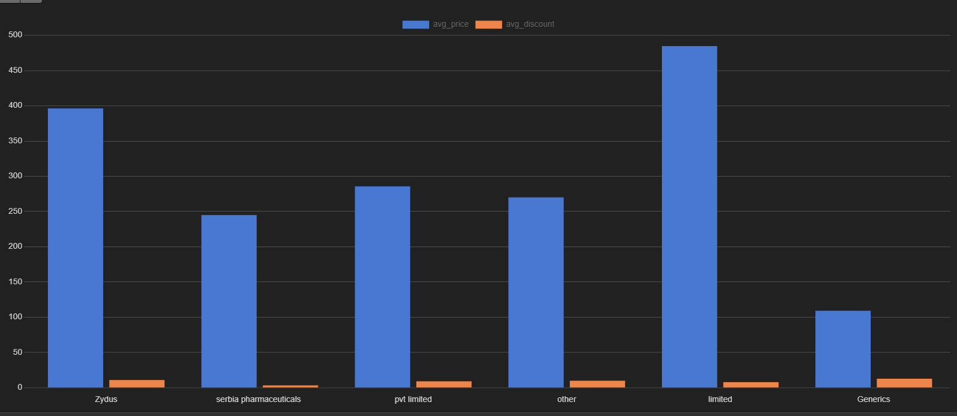
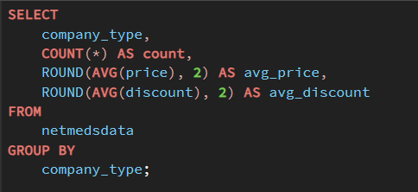
"Company-wise Product Summary: Count, Average Price, and Average Discount Analysis"

